Slide 1
4 BALL GYRO
TORQUE & ANGULAR MOMENTUM
MOTORCYCLE COUNTER-STEERING
J. Ronald Galli
Weber State University

Slide 2
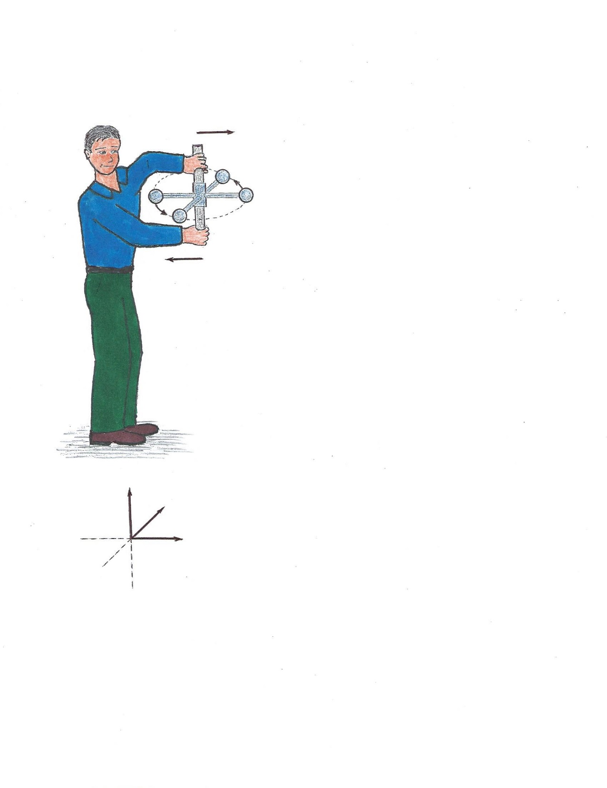
4 BALL GYRO – SIMPLE EXPLANATION
PUSH
2
The masses behave as a spinning wheel with initial motion as shown, in the xy plane.
Next, the left hand pushes out away from the body (x direction) and the right hand pulls back toward the body.
Ball 1 is forced down as it moves left, toward the vertical yz plane.
This forces the left grip to move left and downward.
Similarly, the right grip is forced to move right and upward as ball 3 is forced up while moving right, toward the vertical yz plane.
Thus an initial torque about the y axis causes a twist about the x axis.
3
1
4
PULL
Z
Y
X

Slide 3
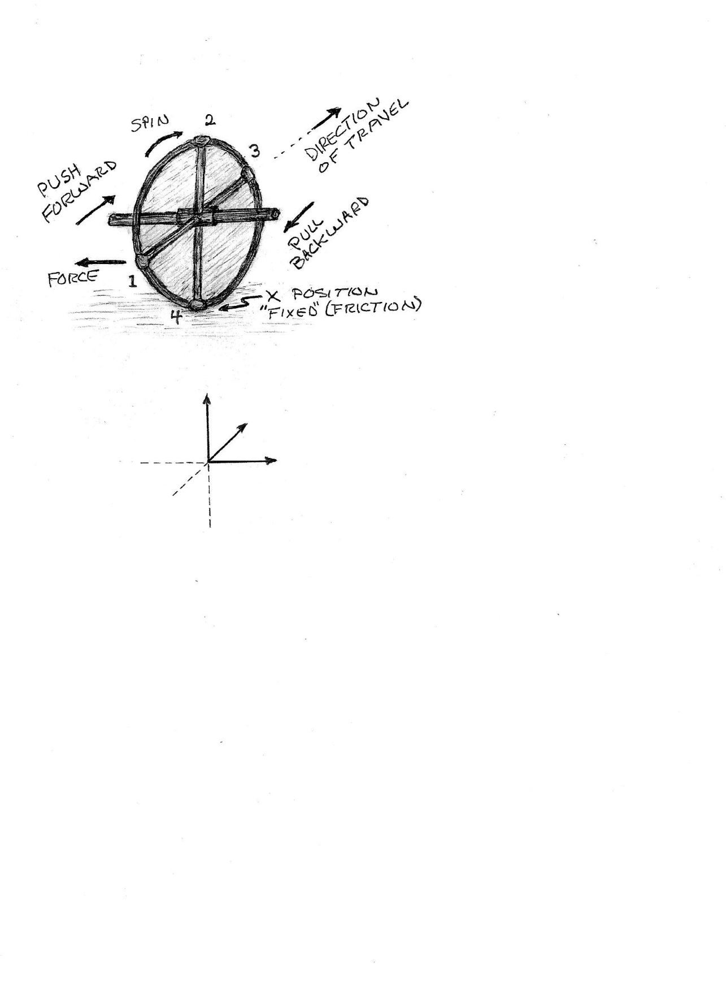
MOTORCYCLE TURN – SIMPLE EXPLANATION
Think of the front wheel of a motorcycle as consisting of 4 heavy balls attached to 4 strong “massless” rods and rolling, as shown, on a smooth “massless” rim.
Ball 1 spins to the top position while being forced to the left (negative x direction) by a push forward on the left handlebar, or a pull backward on the right handlebar.
This causes the wheel and the motorcycle to tilt downward to the left.
Now that the wheel and motorcycle are leaning to the left, a gravitation torque will turn the wheel to make a left turn.
This is like hanging the wheel (or 4 Ball Gyro) from a rope at the end of the right grip.
Z
Y
X
CONCLUSION: Pushing forward on the left grip or pulling back on the right grip will cause the two wheel motorcycle, at highway speeds, to turn TO THE LEFT! WOW!!

Slide 4
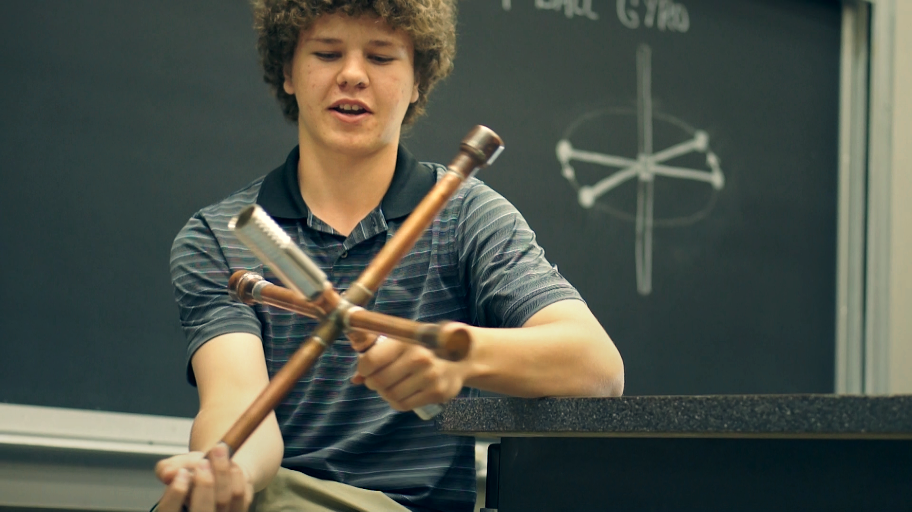
4 BALL GYRO
Copper pipe construction on bicycle axle hub
Four arms, each 10 inches long
Four balls – copper cups, each filled with one pound of lead
Steel handles
Total weight 7 pounds

Slide 5
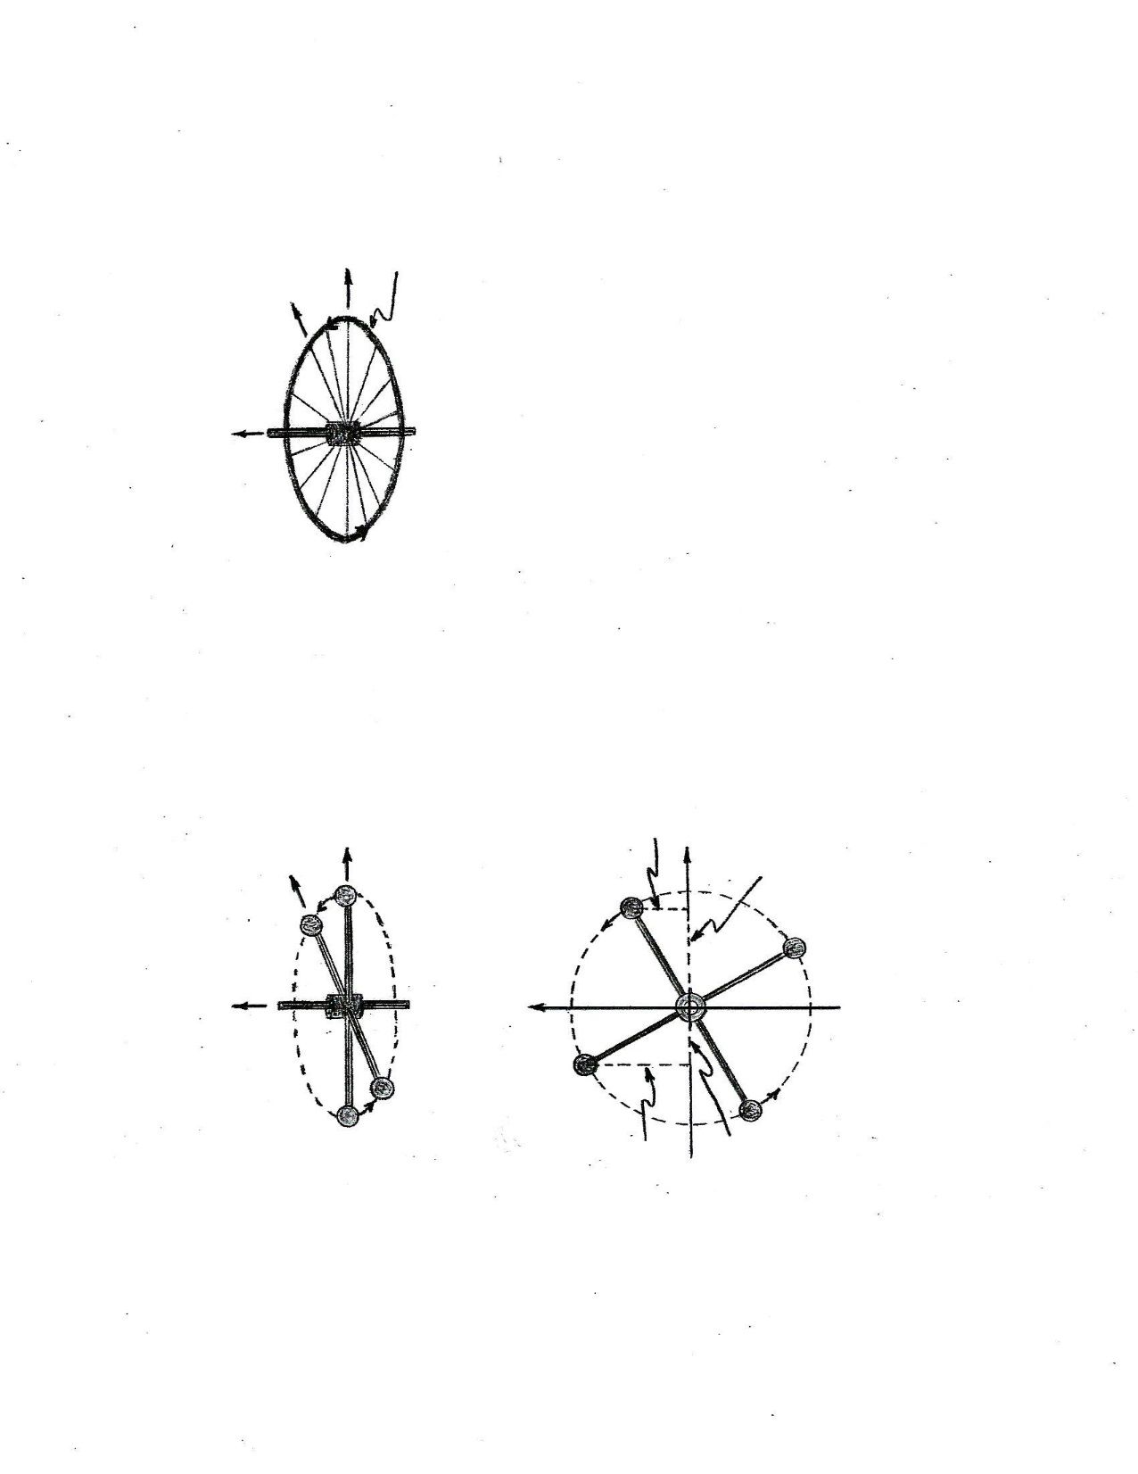
MOMENTS OF INERTIA
4 BALL GYRO
WHEEL RADIUS R
z
z
M
y
y
M
x
x
R
M
M
4M
SPECIAL POSITIONS ON X AND Y AXES
Iz = 4MR² Iz = Ix + Iy
Ix = Iy = Iz⁄2 = 2MR²
Iz = 4MR² Ix = Iy = 2MR²
y
M
Thus the Moments of Inertia about the three principal axes are essentially the same for the 4 ball gyro as for the wheel of the same rim mass and radius. Therefore the equation τ = I will give the same dynamical result for the same torque applied under the same conditions.
This would also be the same for a wheel with 4 additional masses attached to the rim. However Ix, Iy, and Iz would then each be increased accordingly (doubled for example, if all masses are as given herein).
M
y₂
R
y₁
x
α
x₂
M
x₁
M
GENERAL POSITIONS - 90 degree separation
Ix = 2My₁² + 2My₂² y₂ = x₁
Ix = 2M(x₁² + y₁²) = 2MR²
Ix = Iy = 2MR² Iz = 4MR²
z is out of page

Slide 6
FURTHER NOTES
Two Kinds of Force
Force of propulsion (forward or backward) – along the line of motion (motion speeds up or slows down)
Force of deflection for moving object – perpendicular to motion. Changes direction of motion.
Two Kinds of Torque (Twisting Force)
Torque of propulsion (forward or backward) – in the direction of spin (rotation speeds up or slows down)
Torque of deflection for spinning object – perpendicular to spin axis. Changes direction of spin axis.
REFERENCES
Ernest F. Barker, “Elementary Analysis of the Gyroscope”, Am. J. Phys. 28, 808-810 (1960)
Harvey Kaplan and Andrew Hirsch, “Gyroscopic Motion: Show Me the Forces!” Phys. Teach. 52, 30-33 (2014)
A demonstration wheel with 4 masses added is available from www.pasco.com

